Slide 1
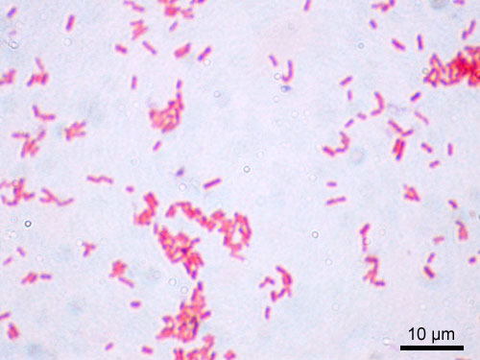
Genus Salmonella
Members of the genus salmonella colonize vertebrate host, with outcomes range from subclinical to systemic infection with high mortality. Animal infection has direct economic consequences, but asymptomatic carriage leading to direct or indirect transmission of human may be more important.
The genus comprises nearly 2500 serovars based on flagellar (H) and somatic (O) antigens. DNA-DNA hybridization analysis revealed that the genus can be divided into two species, salmonella enterica (2443 serovars) and salmonella bongori (20 serovars). Serovar-to-serovar variation in viruence and epidemiology are common in S. enterica. Most serovars cause gastroenteritis, but few (serovar typhi, paratyphi A and C and sendai) cause systemic disease originating in the gastrointestinal tract and other serovars (serovars Cholerasuis and Dublin) are frequently associated with bacteremia and less commonly with diarrhea.

Slide 2
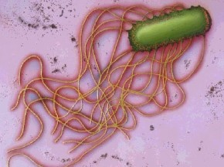
Genus Salmonella
Host adaptation also varies widely, from strong host adaptation of Typhi (human), Pullorum (Poultry), Cholerasuis (swine), Abortus-ovis (sheep), and Dublin (cattle) to relatively low adapted serovar Typhimurium.
Genetic mechanisms underlying the diverse phenotypes in the genus are based in part on polymorphism in genes coding surface structures (Lipopolysaccharide, flagella and fimbria) which are often virulence factors.

Slide 3
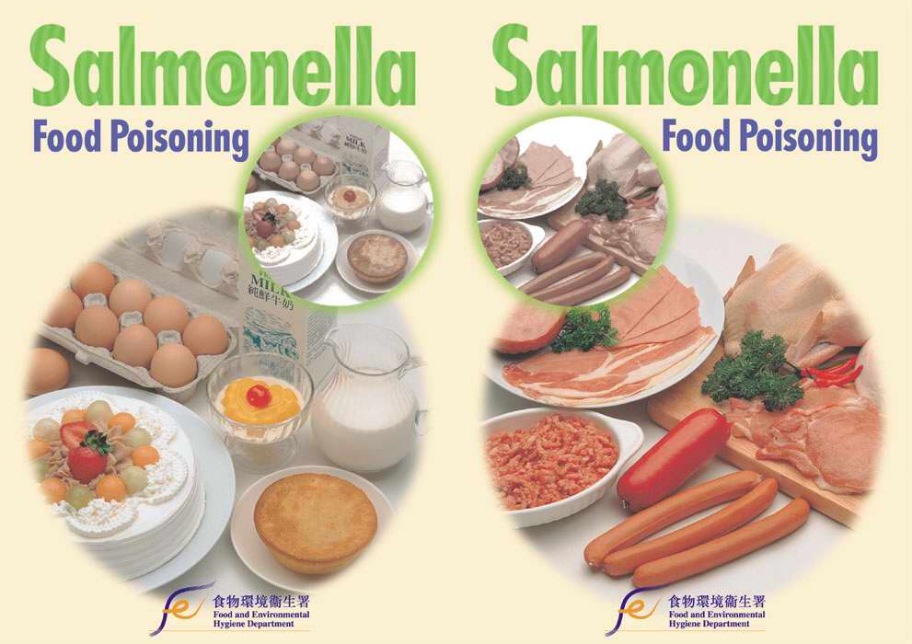
Disease & epidemiology
Disease occurs as peracute septicemia & acute, subacute, or chronic enteritis. Acute disease caused by some serovars e.g. S. typhimurium is charcterised by high morbidity & low mortality, manifested as diarrhea & fever. Dehydration & electrolyte imbalance may be sufficiently severe to be fatal in infection by other serovars (S. Dublin in calves & S. cholerasuis in pigs). Young animals are often more severely affected than adults.
Outbreaks of disease in animals & humans have been associated with S. Newport. The organism has emerged as an important cause of diarrhea outbreaks in horses and diary cattle. The serovar has commonly isolated from human food-borne infections, being recovered from hamburger, chicken, roast beef, potato, salad. Multidrug resistance is a major problem with resistance to chloramphenicol, Bactrim, tetracycline, streptomycin & Cephalosporins.

Slide 4
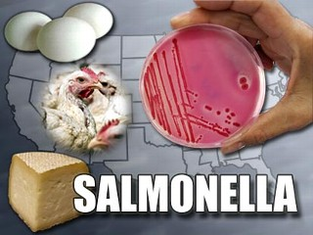
Disease & epidemiology
Calves 1-2 weeks of usually develop enteric symptoms when infected with S. Typhimurium & septicemia with S. Dublin. Most calves recovered & become carriers. Salmonella is rarely life-threatining in adult cattle, but recovered carriers may expose others in the herd & contaminate milk.
S.Gallinarum & S. pullorum cause septicemic disease in turkeys (Fowl typhoid) & chickens. Young chickens often develop fatal septicemia.
Equine salmonellosis is an uncommon, but important problem, especially as a nosocomial infection in veterinary teaching hosptals. S. Typhimurium is encountered most frequently.
Salmonellae reside in the normal vertebrate gastrointestinal tract & asymptomatic carriers among domestic & wild animals & birds introduce the infection to & maintain it in herds & flocks. Foods of animal origin, whole eggs (duck eggs may have higher prevalence of infection) & egg products, meat & meat products & contaminated equipments & utensils are all source of infection.

Slide 5
Host adapted serovars of salmonella enterica
Typhi --- Human (Exclusive)
Paratyphi A, Sendai ----- Human
Dublin ------- cattle
Cholerasuis ------- Swine
Pullorum, Gallinarum ----- Poultry
Abortusequi ------- Horses
Abortusovis ------------- sheep
Arizona ------- Reptiles

Slide 6
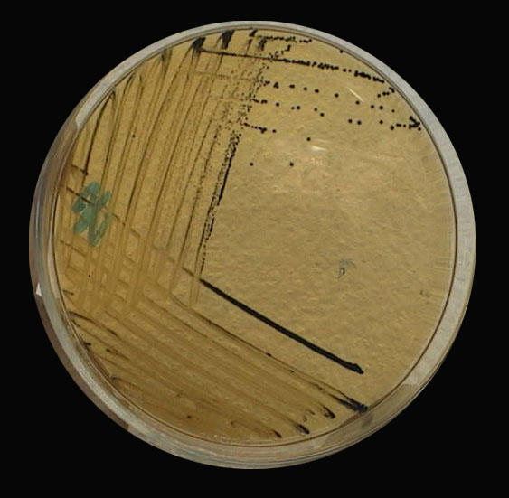
Pathogenesis
Salmonella often enter the host by ingestion, mediate acid resistance of the stomach & move to the small intestine. Salmonellae adhere to & invade enterocytes in order to cause enteritis or systemic disease. Fimbriae & other membrane protein are involved in enterocyte invasion. Flagella contribute to intestinal invasiveness of salmonella spp. Entry of salmonellae usually occurs without mucosal damage in systemic infection, but enteric infection is characterized by local damage without septicemia. Invasion of enterocytes is important & is the major event in disease in some domestic animals (calves).
Invasion followed by inflammation with profusion of neutrophils as a result of production of IL-8. Neutrophils migrate to lamina propria & then to the lumen. Salmonella infection induce secretory diarrhea in a mechanism that does not involve toxin production. Cell death & sloughing allow bacterial invasion of submucosal tissues.

Slide 7
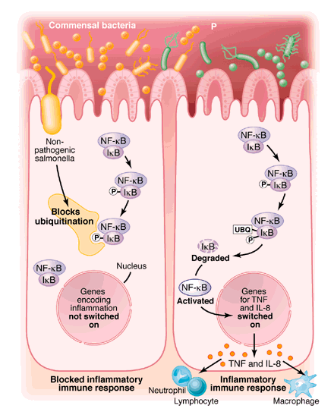
Pathogenesis
Survival & replication in phagocytes, & subsequently in LNs can lead to extraintestinal dissemination. Bacteria delivered to circulation are removed by cell of the RES, particularly in liver & spleen.

Slide 8
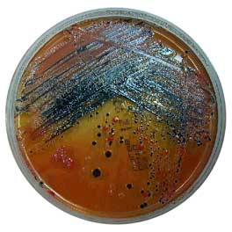
Diagnosis
Salmonellae are facultatively anaerobic, non-spore forming, growing optimally at 37C. All serovars (except Pullorum & Gallinarum) are motile by means of pertrichous flagella. Salmonellae grow directly on selective and differential media and after enrichment in selective broth (tetrathionate broth). Solid media include xylose lysine deoxycholate (XLD) & Hekton enteric (HE) agars, followed by incubation at 37C for at least 12 hrs. On XLD, salmonellae produce pink colonies with black center (due to H2S production). On HE agar, colonies are blue-green with or without black center.
PCR targeting salmonella specific genes facilitate identification.
Biochemical characteristics are useful in diffferentiating species & subspecies. Salmonellae are non-lactose fermentor, except for S.enterica spp. Arizona & S. enterica spp. Diarezona, & do not produce indol or urease, they are also VP -, MR , citrate, H2S production + & most are catalase +

Slide 9
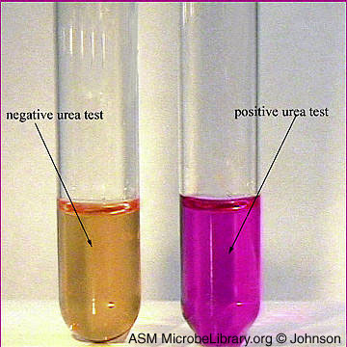
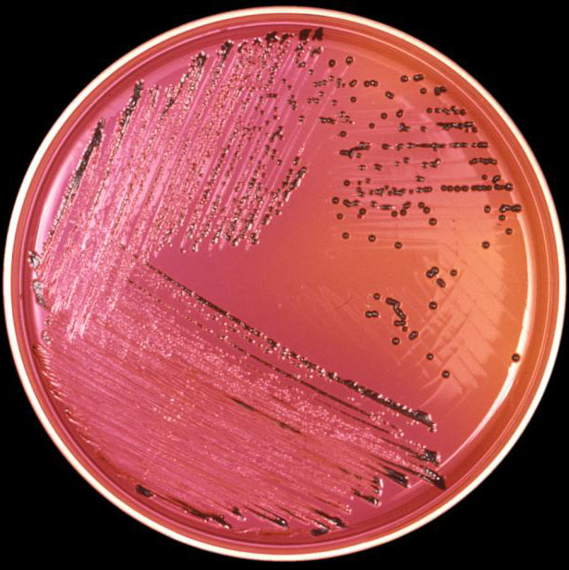
Urease positive. Colonies with black center

